Slide 1
CS 480 Team Project
Project name : CPU information detector
Student name : Yen-Lin , Chiu
Student ID : 9196
Ryan

Slide 2
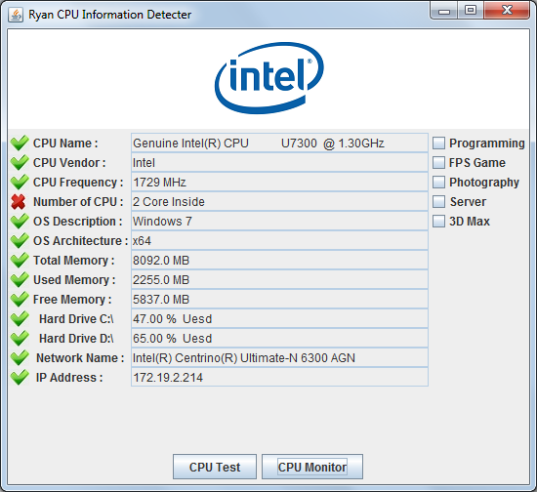
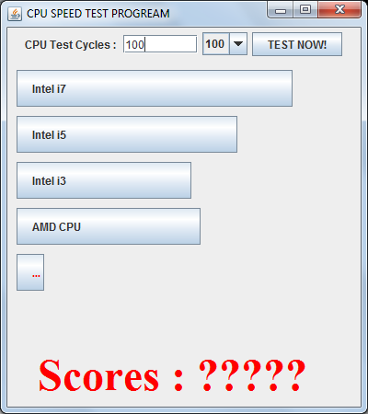
The structure of program
Main Frame
Test Frame
Monitor Frame

Slide 3
The Main frame
BorderLayout.
5 individual JPanel .

Slide 4
Cpu logo panel

Slide 5
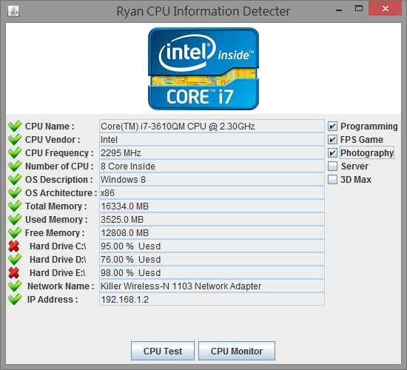
Display information area
Verify
Requirement
choose worked
Check states in real time

Slide 6
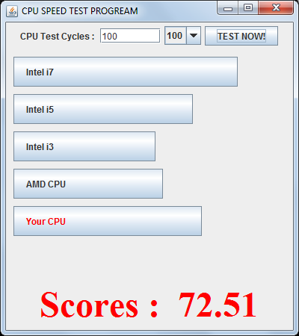
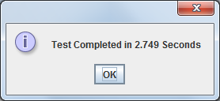
The test frame
Setting number of Cycles
Compare Bar
Result Bar
Show final Scores

Slide 7
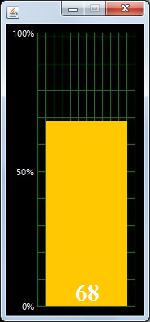
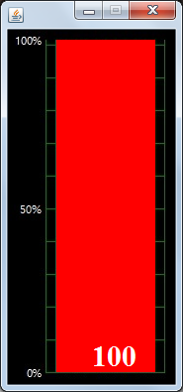
The monitor frame
Used jpg file as a background.
FillRectangle display percentage of CPU.
Over 50%
JLable show percentage.
Under 50%
Over 90%

Slide 8
demonstration

